Slide 1
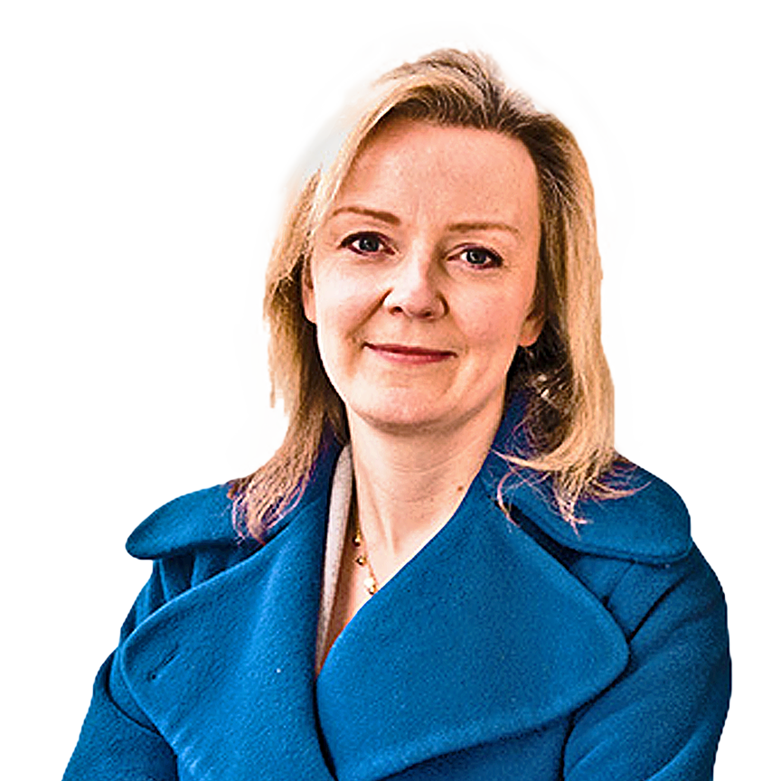
Liz Truss
Prime Minister
Notes:
Does anyone of you know who this person is?

Slide 2
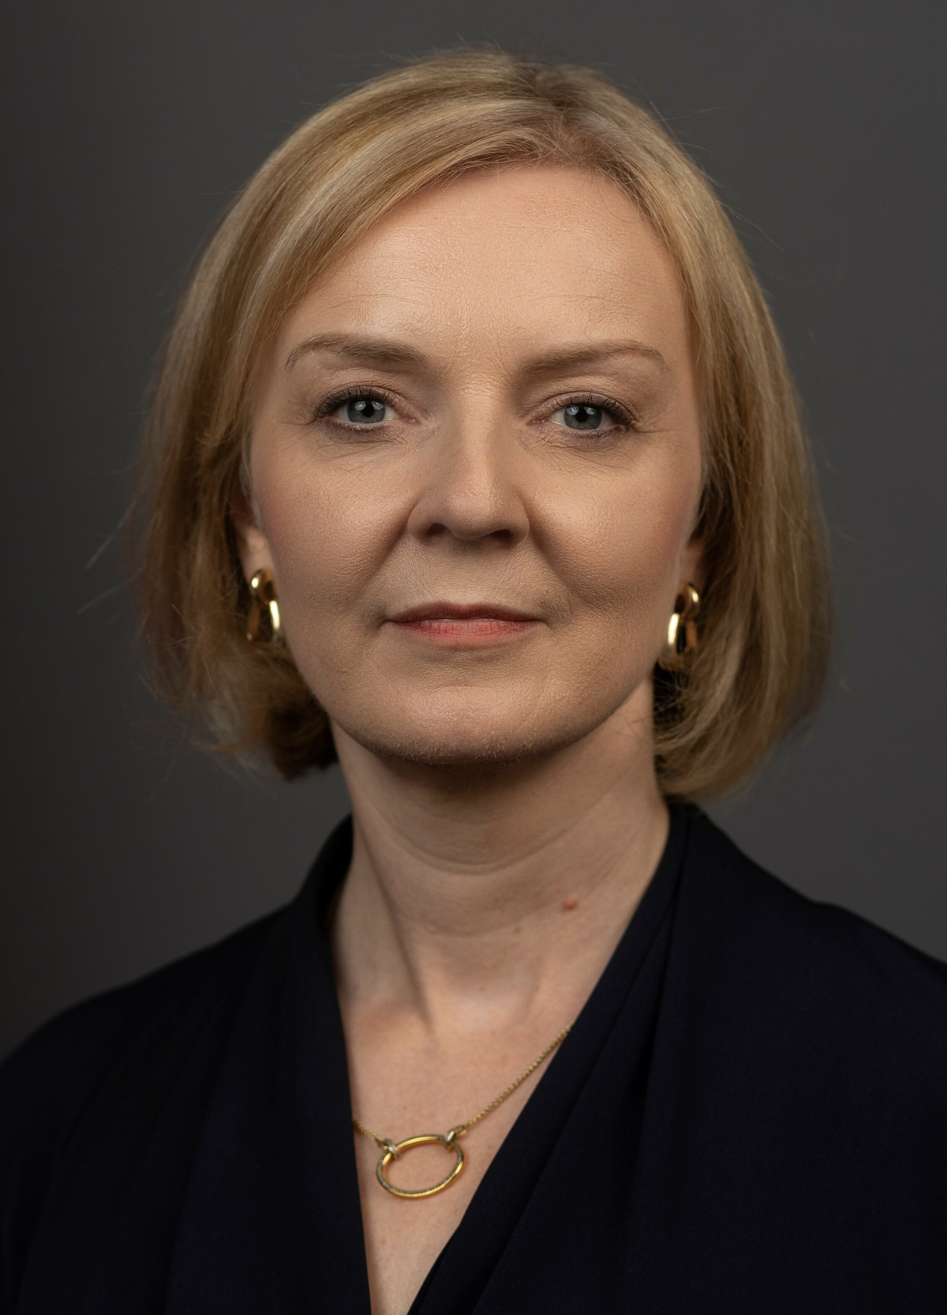
Liz Truss
Prime Minister
BIOGRAPHY
Age | 47 – 26. july 1975
Born in | Oxford
Family | Nurse and mathematics professor
Studies | University of Oxford
2016 -17
2019
2022
Minister of Justice
Chief Secretary to the Treasury
Minister for Women
Notes:
That is correct. This is Liz Truss
That is not correct, the person you can see here is Liz Truss

Slide 3
BIOGRAPHY
Liz Truss
Prime Minister
ELECTION
57%
Liz Truss
Rishi Sunak
42%
Age | 47 – 26. july 1975
Born in | Oxford
Family | Nurse and mathematics professor
Studies | University of Oxford
2016 -17
2019
2022
Minister of Justice
Chief Secretary to the Treasury
Minister for Women
Notes:
Elizabeth Truss also called Liz Truss is a British politician of the Conservative Party and Prime Minister of the United Kingdom since September 6. She was born in Oxford in 1975. She studied philosophy, politics and economics at Oxford University. In 2016 to 2017 she was Justice Minister then Chief Secretary to the Treasury until 2019. From 2019 to 2022, she was Minister for Women and additionally Foreign Secretary of the United Kingdom.

Slide 4
ELECTION
57%
Liz Truss
Rishi Sunak
42%
POLITICAL POSITION
BIOGRAPHY
Age | 47 – 26. july 1975
Born in | Oxford
Family | Nurse and mathematics professor
Studies | University of Oxford
Liberal economic or capitalist views
Aggressive foreign policy stance towards China and Russia
2016 -17
2019
2022
Against Brexit
Residents Relieve
Minister of Justice
Chief Secretary to the Treasury
Minister for Women
Notes:
The election ended on the fifth of september 2022. she narrowly won the election with 57 percent against Rishi Sunak.

Slide 5
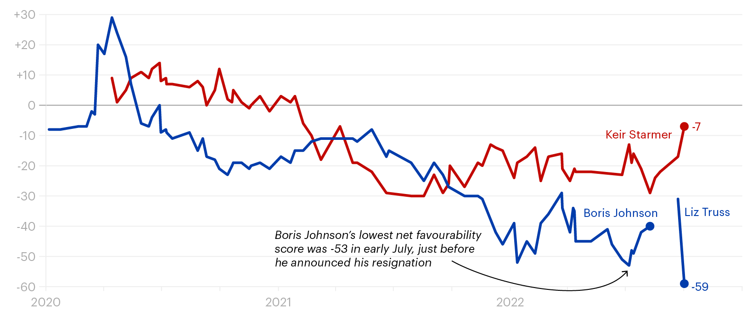
POLITICAL POSITION
POPULARITY
ELECTION
Does a good job
Does a good job
57%
5%
14%
German opinion
British opinion
Liz Truss
Rishi Sunak
42%
Liberal economic or capitalist views
Aggressive foreign policy stance towards China and Russia
Against Brexit
Residents Relieve
Notes:
Truss is known for her liberal economic views and her support of free trade
She has urged Britain to reduce its economic dependence on China and Russia. She also supported sanctions against the two countries
At the beginning she supported the Brexit, but later she apologized for this opinion and said "I was wrong and I am ready to admit that I was wrong". Although she cooperates with the EU, she still stays away from joining it.
She also said she wants to relieve people and help them through the difficult time.

Slide 6
POPULARITY
Does a good job
Does a good job
5%
14%
German opinion
British opinion
POLITICAL POSITION
Liberal economic or capitalist views
Aggressive foreign policy stance towards China and Russia
Against Brexit
Residents Relieve
Notes:
On this chart you can see the rate of satisfaction with Liz Truss and Boris Johnson

Slide 7
POPULARITY
Does a good job
Does a good job
5%
14%
German opinion
British opinion
Notes:
After just one month in office, Liz Truss is already more unpopular than Boris Johnson ever was. I will now come to why this is so.

Slide 8
SCANDALS
Millions fear for their homes

Slide 9
SCANDALS
Millions fear for their homes
Speech at the funeral of the Queen
Notes:
Lower taxes for the rich, increase public debt: This is how Liz Truss wanted to get her country out of the crisis.
The logic, according to Truss’s government, is that cutting personal and corporate tax will trigger an investment boom and kick-start the British economy.
As a result, interest rates on loans are rising, and many people will no longer be able to pay the rates.
Kreditzinsen schießen in die Höhe, viele werden die Raten nicht mehr zahlen können.

Slide 10
SCANDALS
Millions fear for their homes
Speech at the funeral of the Queen
Notes:
2 days after she became Prime Minister, the Queen died. She read her speech at the funeral, and not even authentically. She came under heavy criticism for that.

Slide 11
REFERENCES
https://en.wikipedia.org/wiki/Liz_Truss#Political_positions
https://de.wikipedia.org/wiki/Liz_Truss
https://www.spiegel.de/wirtschaft/liz-truss-politik-stuerzt-grossbritannien-in-die-krise-millionen-briten-bangen-um-ihr-zuhause-a-e9a3db71-0e91-45f7-851e-791cf38cdc51
https://edition.cnn.com/2022/09/28/europe/uk-truss-crisis-labour-starmer-gbr-intl-cmd/index.html
https://yougov.co.uk/topics/politics/articles-reports/2022/10/05/liz-truss-already-less-popular-boris-johnson-ever-

